Slide 1
Song Recommendations
Author: Donna Lee

Slide 2
Dataset description:
Spotify dataset: Song tracks and their attributes
Attributes:
Duration (MS)
Danceability - how suitable a track is for dancing based on a combination of musical elements including tempo, rhythm stability, beat strength, and overall regularity
Energy - Perceptive measure of intensity and activity
Loudness - How loud the music is
Speechiness - Detects the presence of spoken words in a track
Acousticness - How acoustic a song is
Instrumentalness - The amount of vocals in a song
Liveness - This value describes the probability that the song was recorded with a live audience
Valence - Musical positiveness conveyed by a track
Tempo
Release Date
Years: 2000 to 2021
Tracks: 187K

Slide 3
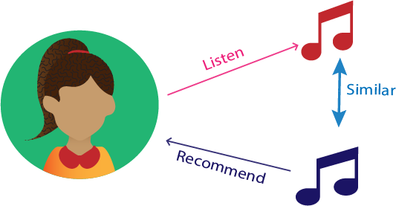
Business Problem:
Based on a given song, I wanted to create a recommendation system based on the features of song. Using the Euclidean distance between the given song and rest of the data set, I came up with ten recommended songs

Slide 4
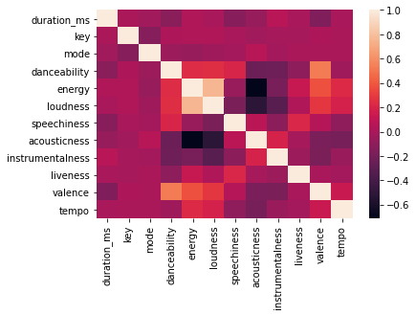
Data Overview:
Given the correlation between the features, there didn’t seem to be a problem of multicollinearity. I decided to use all the features in my recommendation engine

Slide 5
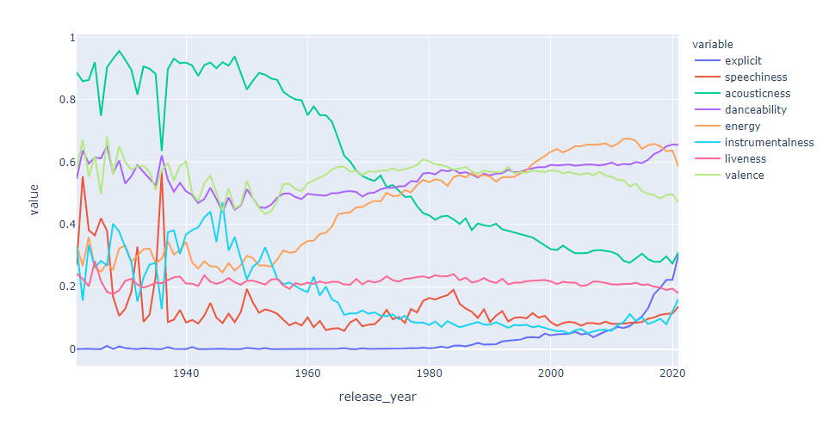
Feature Mean Over Time:
Looking at the mean value of each feature over time, there seems to be a significant decrease in acousticness over time and an increase in energy and danceability

Slide 6
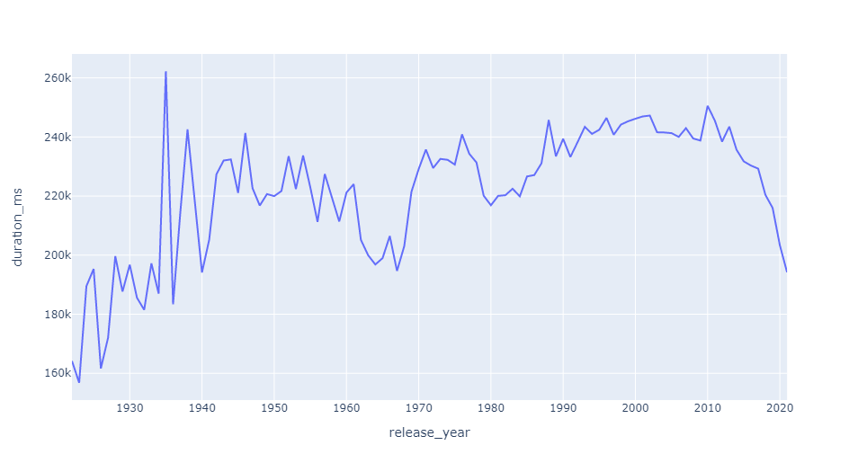
Song Duration Over Time:
Overall song duration has been on the decline in recent years. This is due to a change in how artists get paid. Artists are being paid on steam (if someone listens to 30 seconds of a song) so it is in their best interest to make shorter songs.

Slide 7
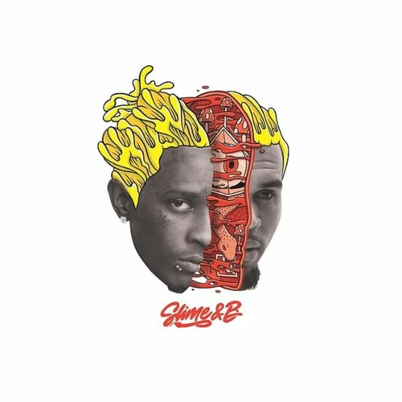
Recommendation System: Let’s test this out!
Savana by Marko Glass
Wish - Trippie Mix by Diplo
Boro Boro vs Nexus by Arash
Donde Estaras by Ricchi E Poveri
Con Roni by ITHAN NY
Chris Brown - Go Crazy

Slide 8
Next Steps:
Add more features such as language into the algorithm
Build a recommendation engine that takes more than one song variable to allow for greater variety in the recommendations

Slide 9
References:
Kaggle Dataset - https://www.kaggle.com/yamaerenay/spotify-dataset-19212020-160k-tracks?select=data_w_genres.csv
Spotify Logo - https://storage.googleapis.com/pr-newsroom-wp/1/2018/11/Spotify_Logo_RGB_Green.png

